Slide 1

Russian’s ICONic constructICON
Laura A. Janda
Anna Endresen
Anna Endresen

Slide 2







A multi-year, multi-national project

Slide 3
Team behind this project
Laura A. Janda (UiT The Arctic University of Norway): Background research, Concept, Design, Data mining, Editing of content, Dissemination of findings and results
Tore Nesset (UiT The Arctic University of Norway): Background research, Concept, Design, Editing of content, Dissemination of findings and results
Ekaterina Rakhilina (National Research University Higher School of Economics in Moscow, Vinogradov Institute of Russian Language at Russian Academy of Sciences): Background research, Concept, Design, Content, Data mining, Semantic annotation, Editing, Dissemination of findings and results
Olga Lyashevskaya (National Research University Higher School of Economics in Moscow, Vinogradov Institute of Russian Language at Russian Academy of Sciences): Concept, Design, Data mining, UD analysis, Syntactic annotation, Dissemination of findings and results
Francis M. Tyers (Indiana University; earlier affiliated with UiT The Arctic University of Norway and National Research University Higher School of Economics): Concept, Design, UD for Russian
Radovan Bast (UiT The Arctic University of Norway, Department of information technology): New user interface, design and programming
Marianne Lund: Translation of definitions to Norwegian
Valentina Zhukova (National Research University Higher School of Economics in Moscow): Content, Design, Data mining, Semantic and syntactic annotation, Dissemination of findings and results
Daria Mordashova (Lomonosov Moscow State University, Institute of Linguistics of the Russian Academy of Sciences): Content, Design, Data mining, Semantic and syntactic annotation, Dissemination of findings and results
Anna Endresen (UiT The Arctic University of Norway): Content, Design, Data mining, Editing, Semantic and syntactic annotation, Usage labels, Dissemination of findings and results, Coordination of teamwork

Slide 4
Team behind this project
Laura A. Janda (UiT The Arctic University of Norway): Background research, Concept, Design, Data mining, Editing of content, Dissemination of findings and results
Tore Nesset (UiT The Arctic University of Norway): Background research, Concept, Design, Editing of content, Dissemination of findings and results
Ekaterina Rakhilina (National Research University Higher School of Economics in Moscow, Vinogradov Institute of Russian Language at Russian Academy of Sciences): Background research, Concept, Design, Content, Data mining, Semantic annotation, Editing, Dissemination of findings and results
Olga Lyashevskaya (National Research University Higher School of Economics in Moscow, Vinogradov Institute of Russian Language at Russian Academy of Sciences): Concept, Design, Data mining, UD analysis, Syntactic annotation, Dissemination of findings and results
Francis M. Tyers (Indiana University; earlier affiliated with UiT The Arctic University of Norway and National Research University Higher School of Economics): Concept, Design, UD for Russian
Radovan Bast (UiT The Arctic University of Norway, Department of information technology): New user interface, design and programming
Marianne Lund: Translation of definitions to Norwegian
Valentina Zhukova (National Research University Higher School of Economics in Moscow): Content, Design, Data mining, Semantic and syntactic annotation, Dissemination of findings and results
Daria Mordashova (Lomonosov Moscow State University, Institute of Linguistics of the Russian Academy of Sciences): Content, Design, Data mining, Semantic and syntactic annotation, Dissemination of findings and results
Anna Endresen (UiT The Arctic University of Norway): Content, Design, Data mining, Editing, Semantic and syntactic annotation, Usage labels, Dissemination of findings and results, Coordination of teamwork
PLUS:
over 40 students at
UiT (Tromsø) and
HSE (Moscow)

Slide 5
Overview: the Russian Constructicon
Why and How We Built It
Semantic Classification
A Tour

Slide 6
Overview: the Russian Constructicon
Why and How We Built It
Semantic Classification
A Tour
Main Point:
We take seriously Fillmore’s (2008) claim that a language is a structured inventory of constructions, a constructicon

Slide 7
Why and How We Built It

Slide 8
Why build a constructicon?
For linguists
to achieve improved description of languages
to extend theory of construction grammar
to facilitate cross-linguistic typological comparison
For L2 learners
to achieve greater language proficiency
to motivate use of specific wordforms
to fill in gaps in current language resources and pedagogy

Slide 9
For Linguists: Theoretical premises
CxG: numerous thorough studies of individual constructions found in various languages
Yet little is known about how the semantics of the entire system of constructions unfolds in a single language.
What are the major types of meanings that multi-word grammatical constructions can encode?
What semantic types of constructions are attested more often than others?
Do various types of constructional meaning form a coherent system?
We need a relatively large inventory of constructions of a single language, and a detailed description of this inventory, a constructicon.

Slide 10
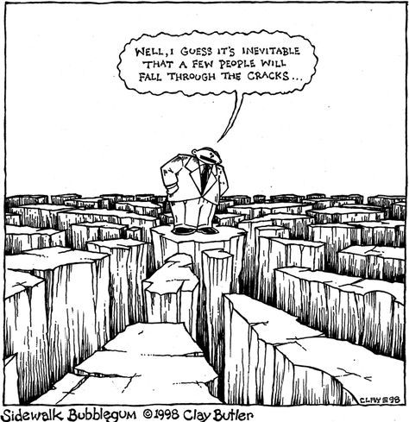
For Learners: Filling in the gaps
It seems that a few things
just fall through the cracks
Dictionaries, grammars, and textbooks focus primarily on lexemes, lexicalized idioms, inflectional paradigms,and grammatical patterns
Multi-word expressions with open slots are less reliably represented in standard resources
TEXTBOOK
PHRASE
BOOK
GLOSSARY
DICTIONARY
REFERENCE
GRAMMAR

Slide 11

Examples of Russian constructions
morphemes
-t’ = INF
lexemes
tancevat’ ‘dance’
multi-word idioms where all slots are fixed
tancevat’ ot Adama ‘start from the very beginning’
multi-word expressions with open slots
VP pod NP-Acc
Ona tancevala pod muzyku ‘She danced to the music’
larger discourse units
Our project focuses mainly on this type of construction

Slide 12
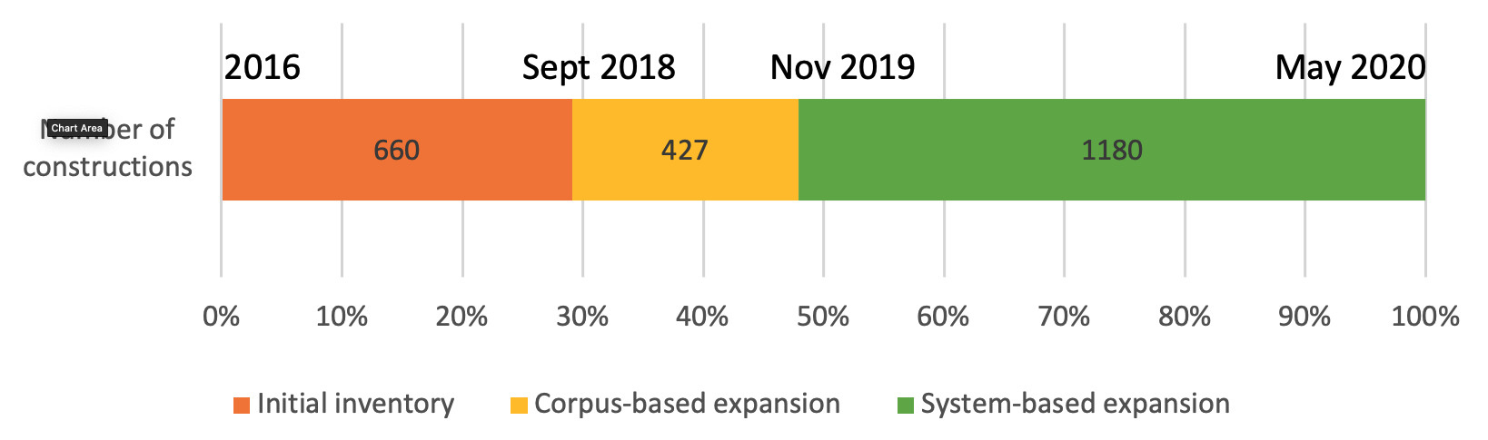
How we built our constructicon
Manual collection from textbooks, scholarly literature, crowdsourcing
Extraction from dialogs, spoken discourse, and RNC collocations
Classification of syntactic & semantic types
Searches for synonyms, antonyms and anchor words based on semantic classification

Slide 13

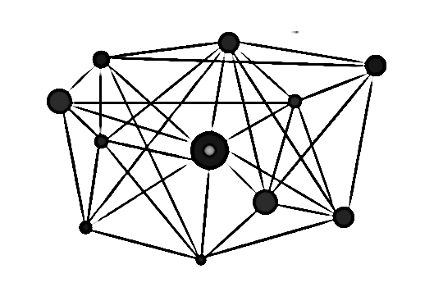
Practical considerations
How exactly to turn a list of collected items into a structured inventory?
This is a practical challenge that all existing constructicons face.
Other constructicons are closely connected to a FrameNet resource and focus on verb argument constructions.
FrameNet has been suggested as an alternative (Fillmore and Atkins 1992; Fillmore et al. 2012).
In other constructicons, constructions are classified semantically according frames they envoke (Ohara 2014, 2018; Boas et al. 2016; Torrent et al. 2014, Lee-Goldman & Petruck 2018).

Slide 14
Why frame semantics is not enough
Frame semantics focuses on Predicate Argument constructions, which constitute only 8% (184 items) of our database
Our Constructicon includes a larger variety of conventionalized form-meaning pairings that can be understood as an early stage in the process of grammaticalization, in which quasigramatical meanings are distributed across constructions and their (partially bleached) anchor words
Classification rests on various classifications of Universal grammatical inventory discussed in a wide range of typological studies (cf. Bybee et al 1994, Melchuk 1993-2000).

Slide 15
Bottom up approach
Our aim
to analyze constructions on their own terms, allowing patterns to emerge from the data, not imposing other models
Methodology
We annotated individual constructions by assigning semantic tags that capture relevant aspects of their meaning
The annotation of constructions was carried out by a panel of three native speakers
The taggers worked together as a team over a long period of time
Reaching a consensus about annotation of each construction

Slide 16
Semantic Classification

Slide 17
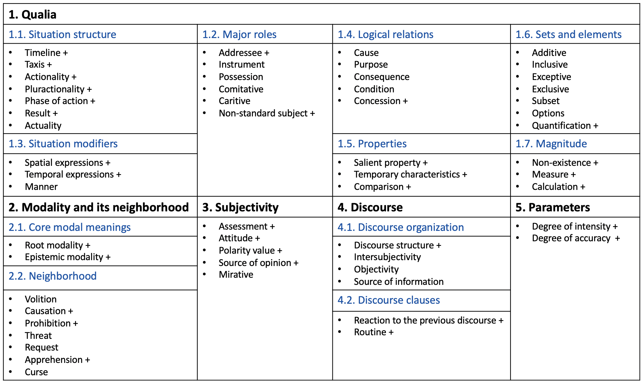
Semantic types of constructions grouped into classes and subclasses
A visualization of 55 semantic types of constructions groupped into subclasses and classes
182 semantic subtypes of constructions

Slide 18
1. Semantic class Qualia
— constructions that describe the properties of the given objective physical world, external to the speaker

Slide 19
2. Semantic class Modality and its neighborhood

Slide 20
3. Semantic class Subjectivity
— constructions that encode the subjective evaluation of a situation, its elements or participants by the speaker.

Slide 21
4. Semantic class Discourse
— constructions that function at the discourse level:
structure the text
organize the communication
refer to a broader context than a single sentence

Slide 22
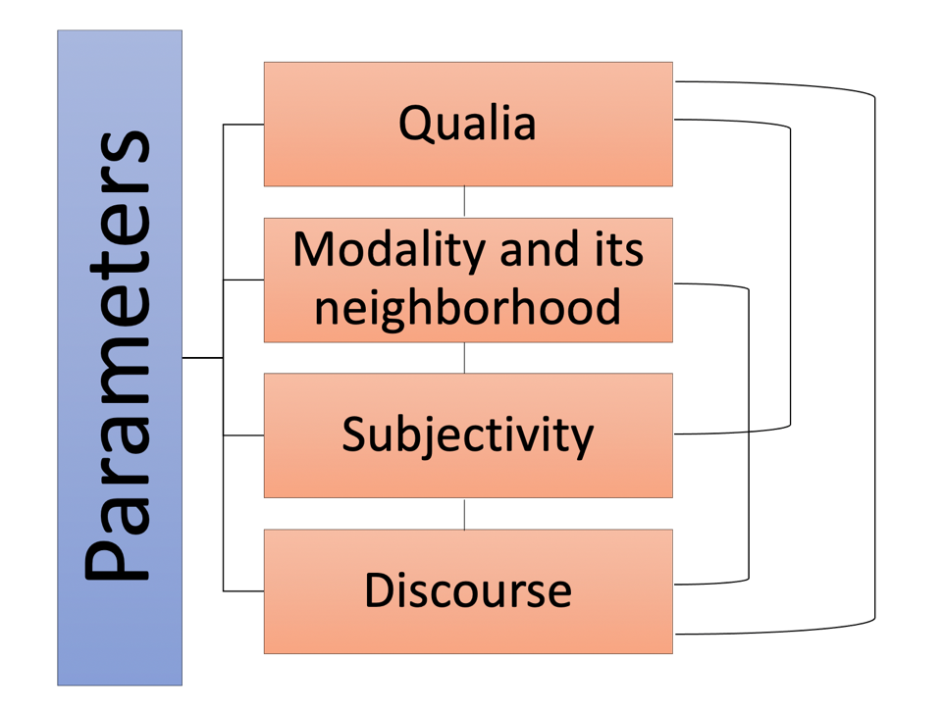
5. Semantic class Parameters
imply a scale that serves as a point of reference for a property or a situation characterized by a construction
can apply to and "build over" other meanings

Slide 23
Classification of constructions
Families
a family is a relatively homogeneous group of approx. 2-9 constructions that share some semantic, syntactic, and/or structural properties
the constructions in a family share various subsets of these properties
semantic and syntactic tags facilitate identification of families
annotation by a panel of three native speakers
Clusters
a cluster is a group of families that are linked through semantic and/or syntactic similarities in a prototypical vs. peripheral distribution, usually corresponding to semantic subtypes in annotation
Networks
a network is a group of clusters that share a general semantic tag
NEXT: Modality and its neighborhood, zooming in on two clusters of Prohibitive constructions

Slide 24
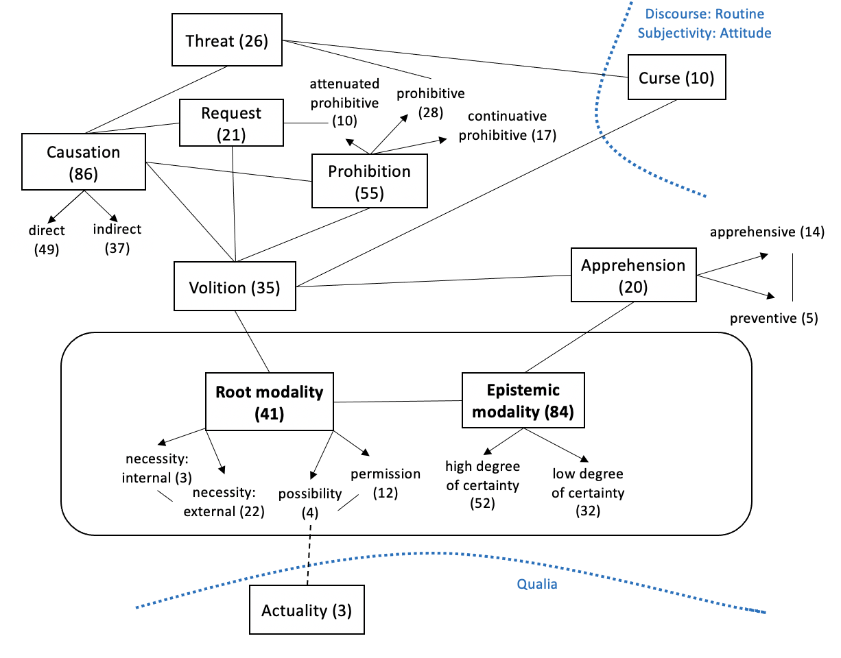
Class of constructions: Modality and its neighborhood
301 constructions
Can be modelled as a radial category – central "core" modal meanings and their neighborhood
Includes 10 semantic types (visualized as boxes)
Arrows indicate subtypes of semantic types
Numbers in ( ) – type frequency of each type in terms of individual constructions
Solid lines – connections between types within this class
Dashed lines – overlaps with other classes (indicated by dotted blue lines)

Slide 25

Vot by (NP-Dat) (nikogda ne/vsegda) VP-Inf!
Vot by nikogda ne rabotat’!
‘Wouldn’t it be great if one never had to work!’
((Ja) bojus’,) kak by ne VP-Pfv.Pst
Kak by Miša ne opozdal!
‘I’m afraid Misha could be late!’
(NP-Dat) Cop možno VP-Inf
Do Moskvy iz Londona možno doletet’ za četyre časa.
‘One can fly to Moscow from London in 4 hours’.
Ne strašno/ničego, esli Cl?
Ne strašno, esli ja zakurju?
‘Would you mind if I smoke?’

Slide 26
Legend:
overlap with Intensity
semantic transitions
syntactic/formal similarities
1:2 (7 constructions)
General rules
Ne VP-Inf!
‘No X-ing!’
weaker relationships
1:4 (7 constructions)
Prohibition of smallest portion
Nikakix NP-Gen!
‘No X-es!’
1:5 (3 constructions)
Anticipation of resistance
Ne VP-Fut.2!
‘You’re not going to do X!’
overlap with other networks of cxns
Cluster 1
predicative
generalization
intensification
opposition to resistance
generalization
option
opposition to repetition
overlap with Request
1:3 (9 constructions)
Milder tone
(NP-Dat) ne stoit VP-Inf
‘There’s no point in X-ing’
1:1 (4 constructions)
Prevention of intended activity
Ne smej VP-Imp.Inf
‘Don’t you dare X’
1:6 (2 constructions)
Prohibition against repeating
Čtob(y) Pron bol’še ne VP-Past!
‘No more X-ing!’
overlap with Warning
attenuation
predicative
continuative
imperative
continuative
continuative
2:2 (7 constructions)
Quantitative, milder tone
Xvatit (Pron.2-Dat) VP-Imp.Inf!
‘Enough X-ing!’
2:1 (4 constructions)
Stop unwanted activity
Brosit’-Imper VP-Imp.Inf
‘Stop X-ing!’
aggression
2:5 (3 constructions)
Prohibition and Threat
Ja Pron-Dat VP-Fut!
‘You do X and you will regret it!’
overlap with Threat
attenuation
imperative
option
Cluster 2
further attenuation
imperative
temporary
Network of Prohibitive constructions
2:3 (2 constructions)
Delimitative
po-VP-Imp.Past i xvatit
‘You’ve done enough X-ing’
imperative
option, po- prefix option
2:4 (3 constructions)
Stop temporarily
Podoždat’-Imper VP-Imp.Inf
‘Stop X-ing for a while’
po- prefix
Notes:
В текст: All CxNs in Cluster 1 contain overt markers of negation, such markers are absent from Cluster 2
Lines represent the relationships that hold among families and are tagged for semantic transitions and shared formal properties – для краткости
В текст в конце: вывод о том, что все семьи связаны

Slide 27
Constructions of this type refer to a successful realization of an action (manage, cf. Plungian & van der Auwera 1998: 104), or “the successful result of the ability” (Aijmer 2004: 62).
Actuality (or acquisitive modality, cf. van der Auwera et al. 2009) as a category lies at the intersection of Modality (Possibility) and Aspect (Perfective).
NP-Dat udalos’ VP-Inf
Miše udalos’ pokurit’.
‘Misha managed to smoke’.

Slide 28
A Tour

Slide 29
https://constructicon.github.io/russian/

Slide 30
The Russian Constructicon
Over 2200 constructions
Arguably the largest openly available constructicon resource for any language
User-friendly for linguists, teachers, learners
Searchable according to semantics, anchor words, syntax
Open-source, publicly archived data
Designed to be portable to other languages, reproducible

Slide 31
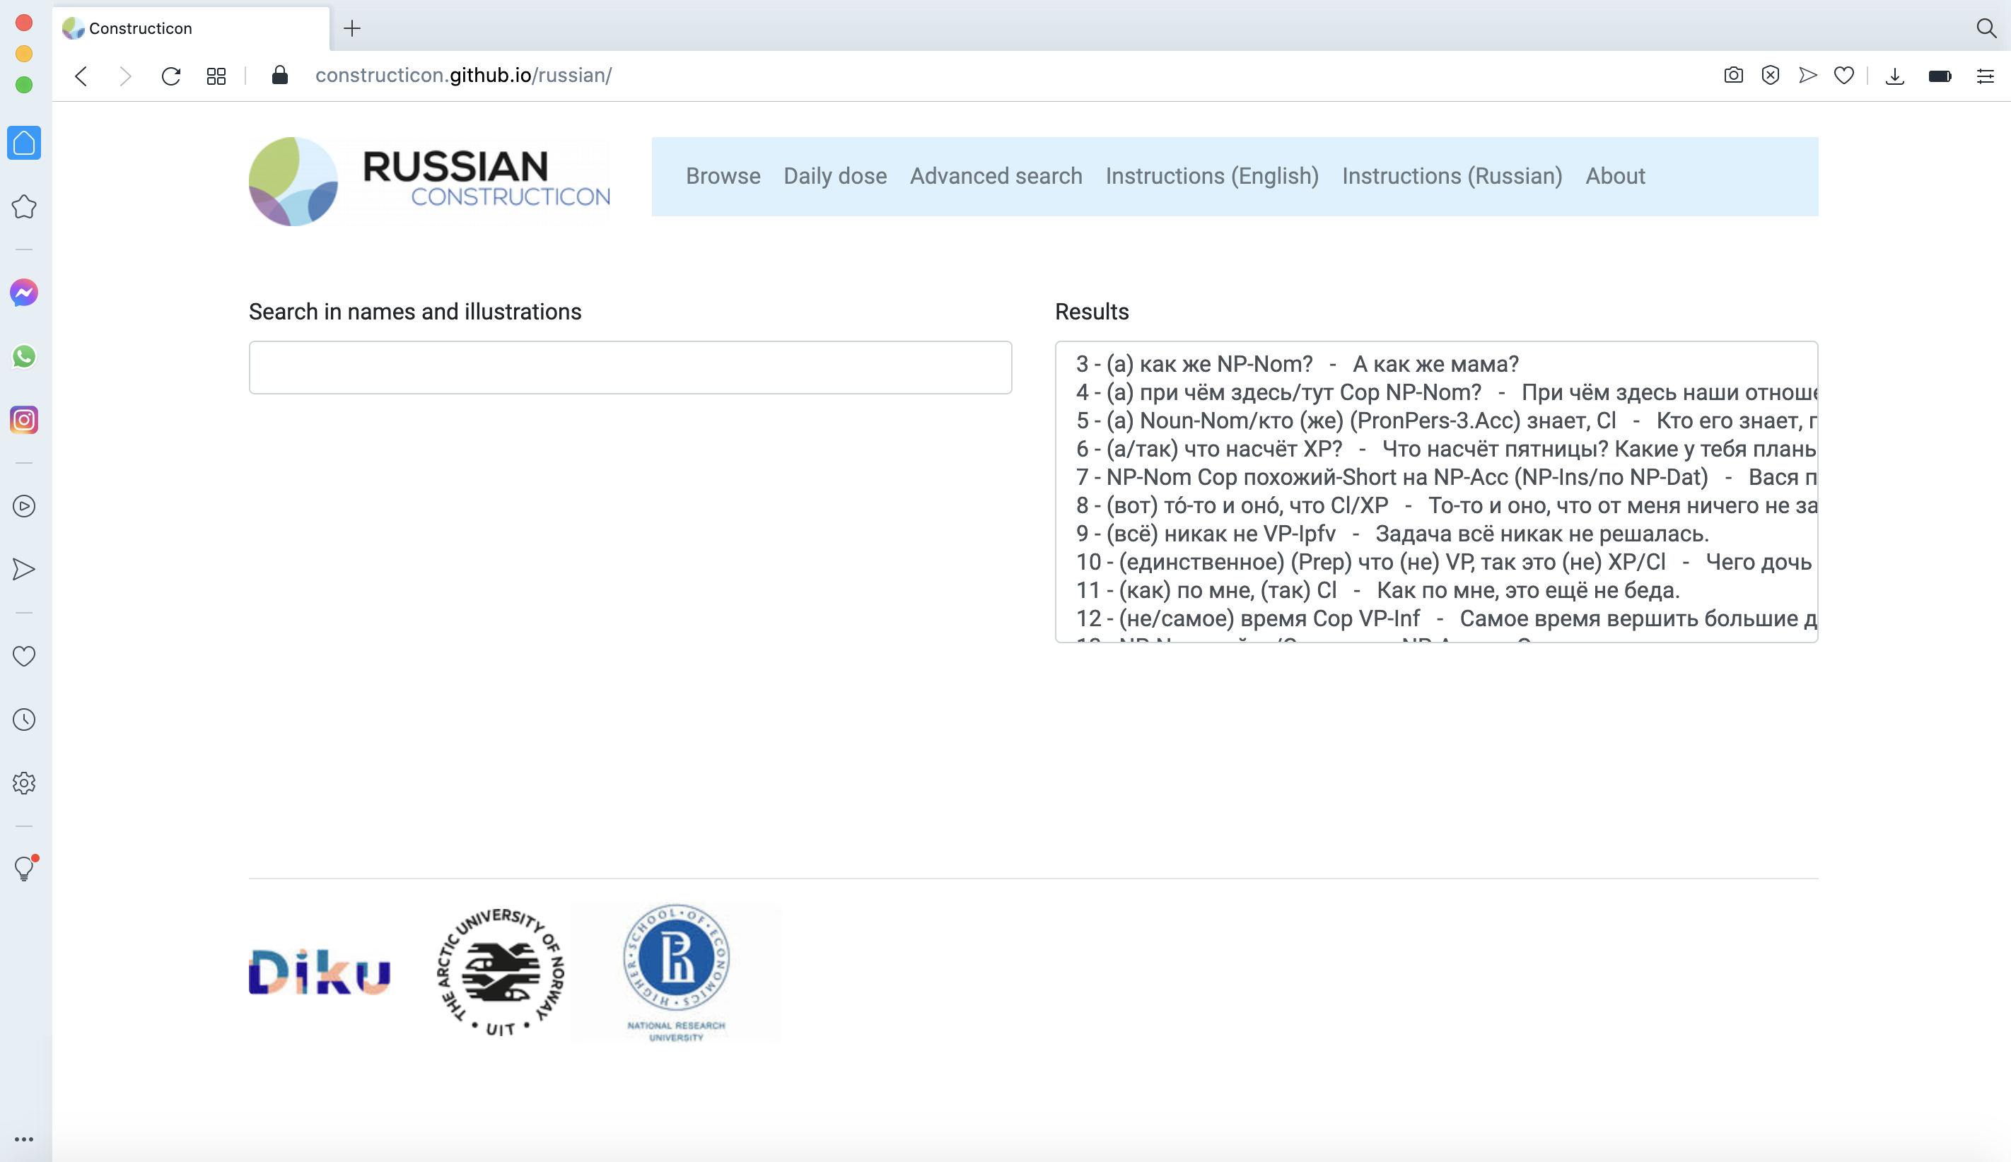

Go to Browse, find the window on the right and scroll through the list of constructions, or type key words or abbreviations in the search box.
Pick any construction, click on it and its description will appear at the bottom of the same page.

Slide 32
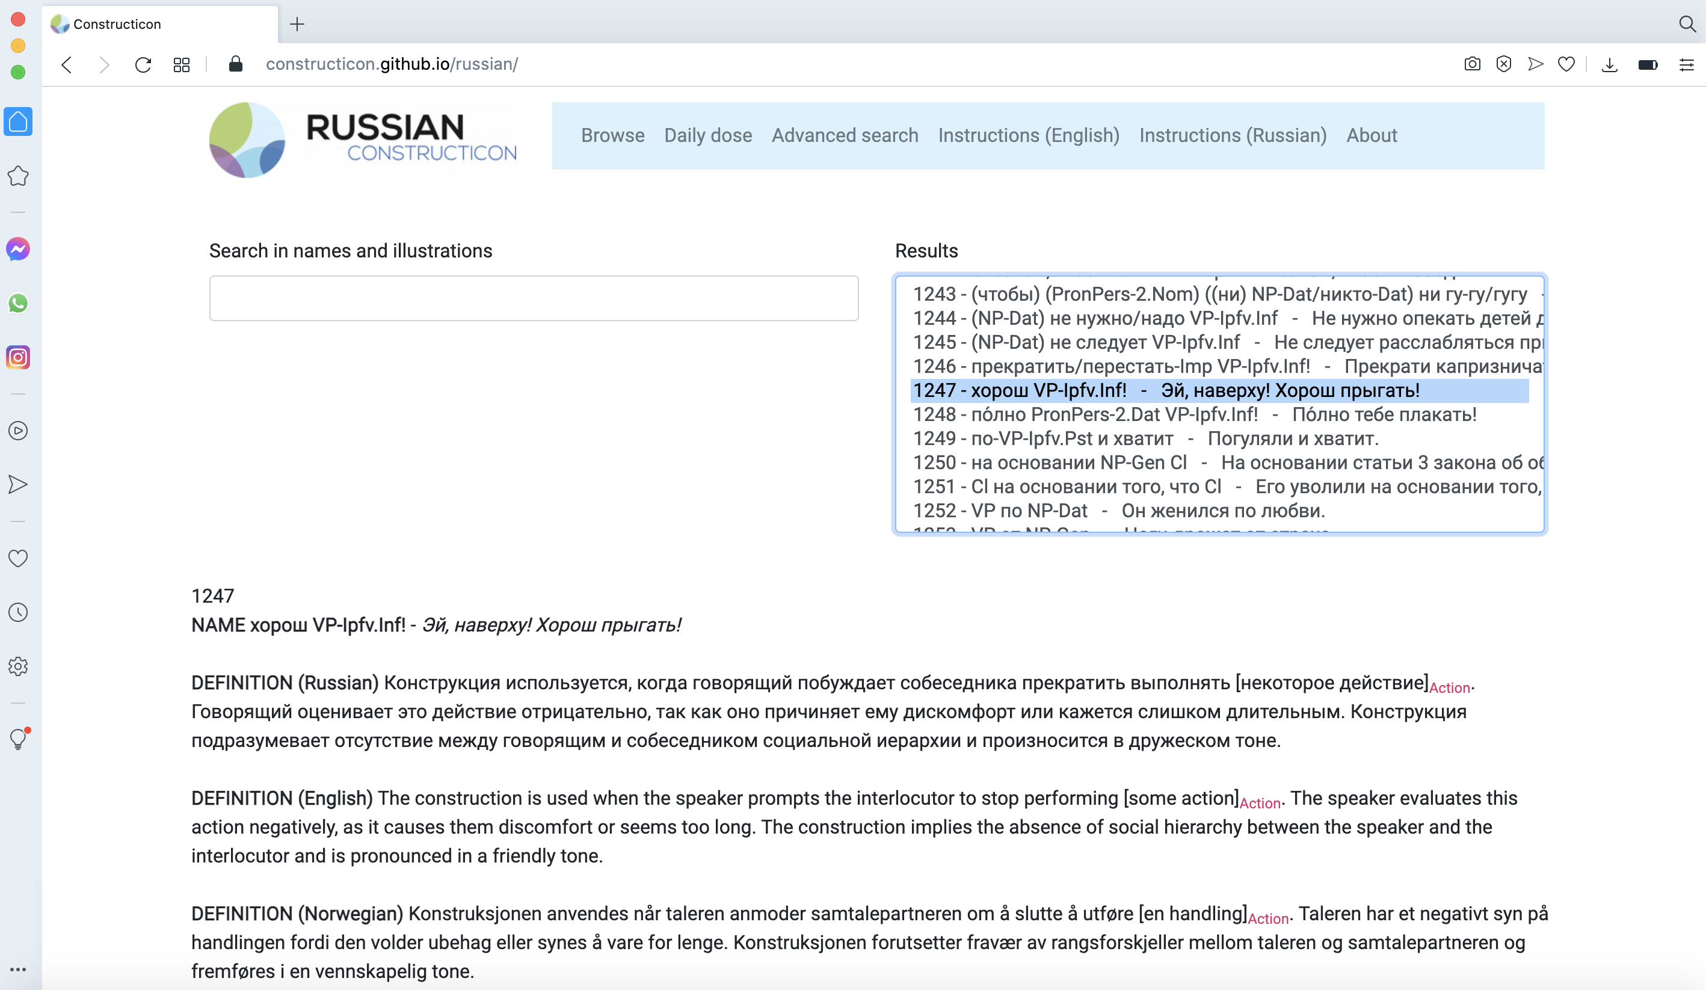
Each construction is represented here by its ID number, its name (a generalized morphosyntactic formula), and a short recognizable illustration.
ID number
Name
Illustration
Notes:
Let us pick the construction Хорош plus verb phrase. Хорош прыгать.

Slide 33
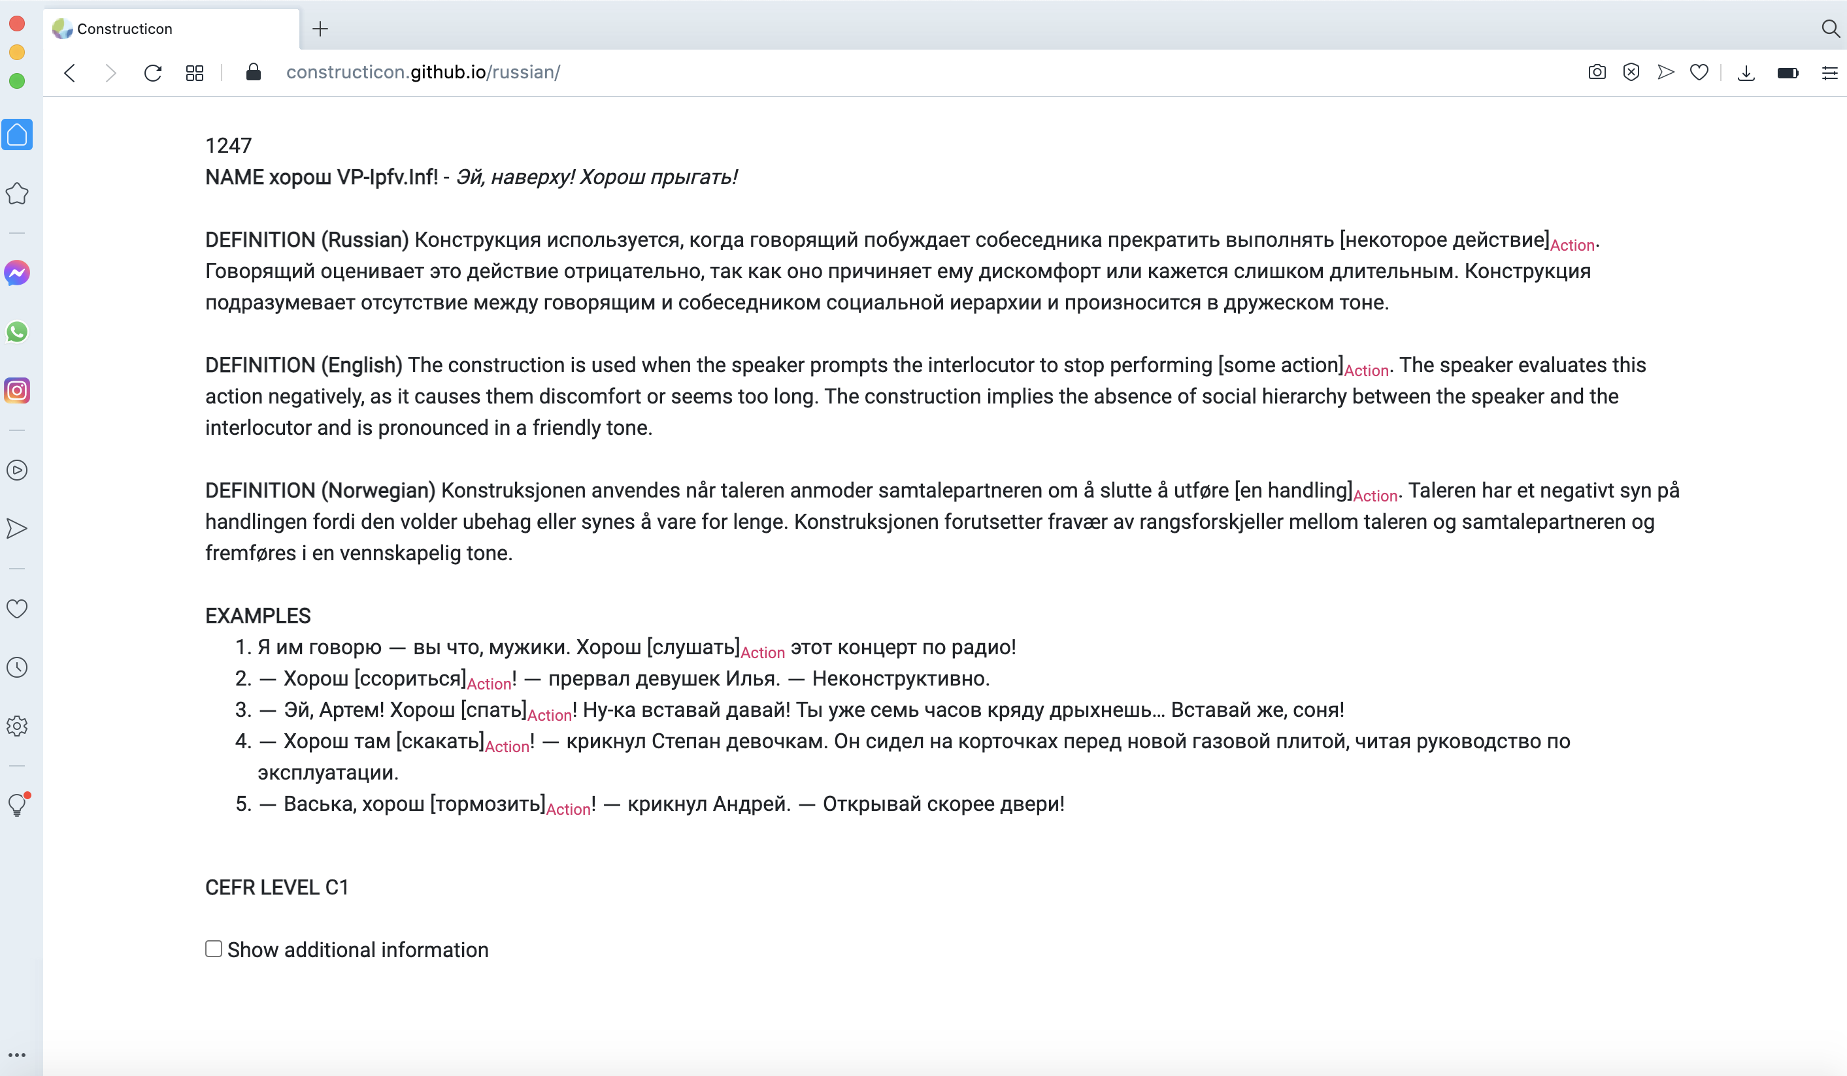
Scroll down, press "Show additional info",
and more information will appear.

Slide 34
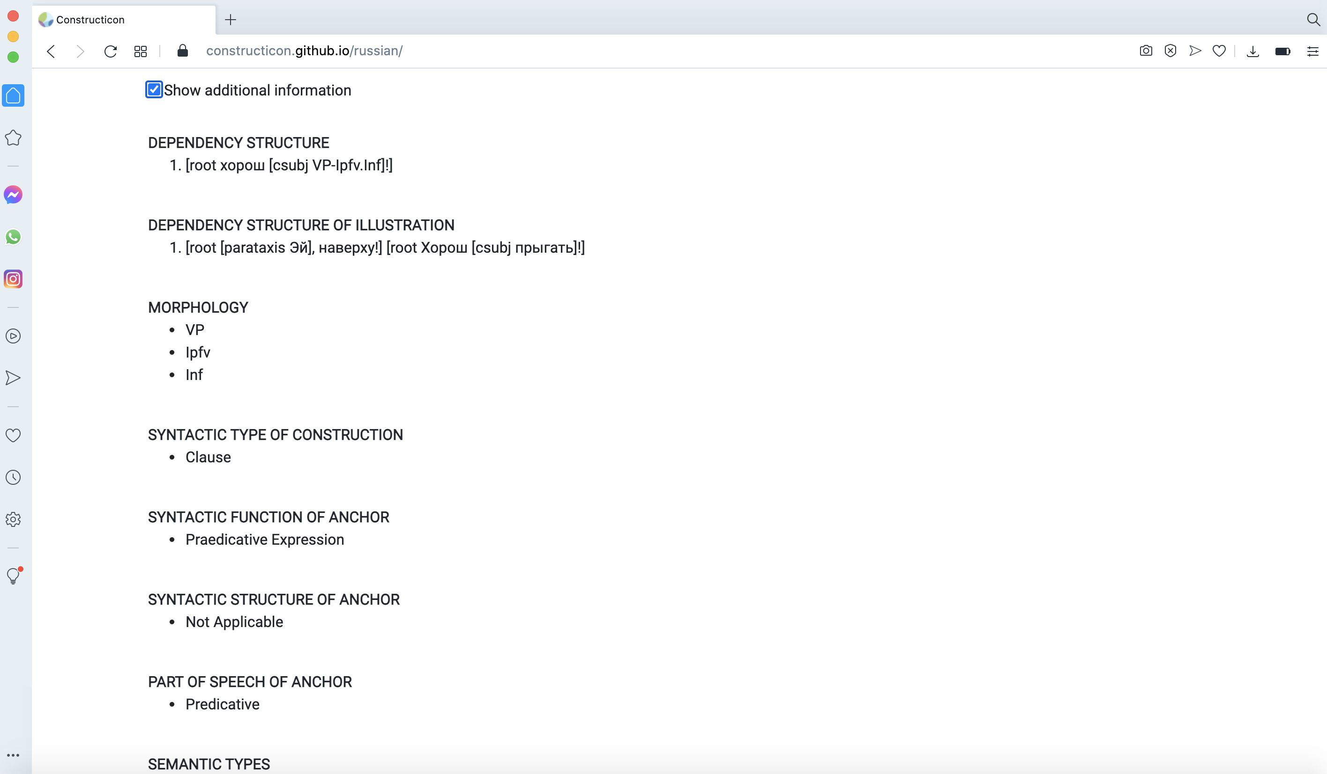

Slide 35
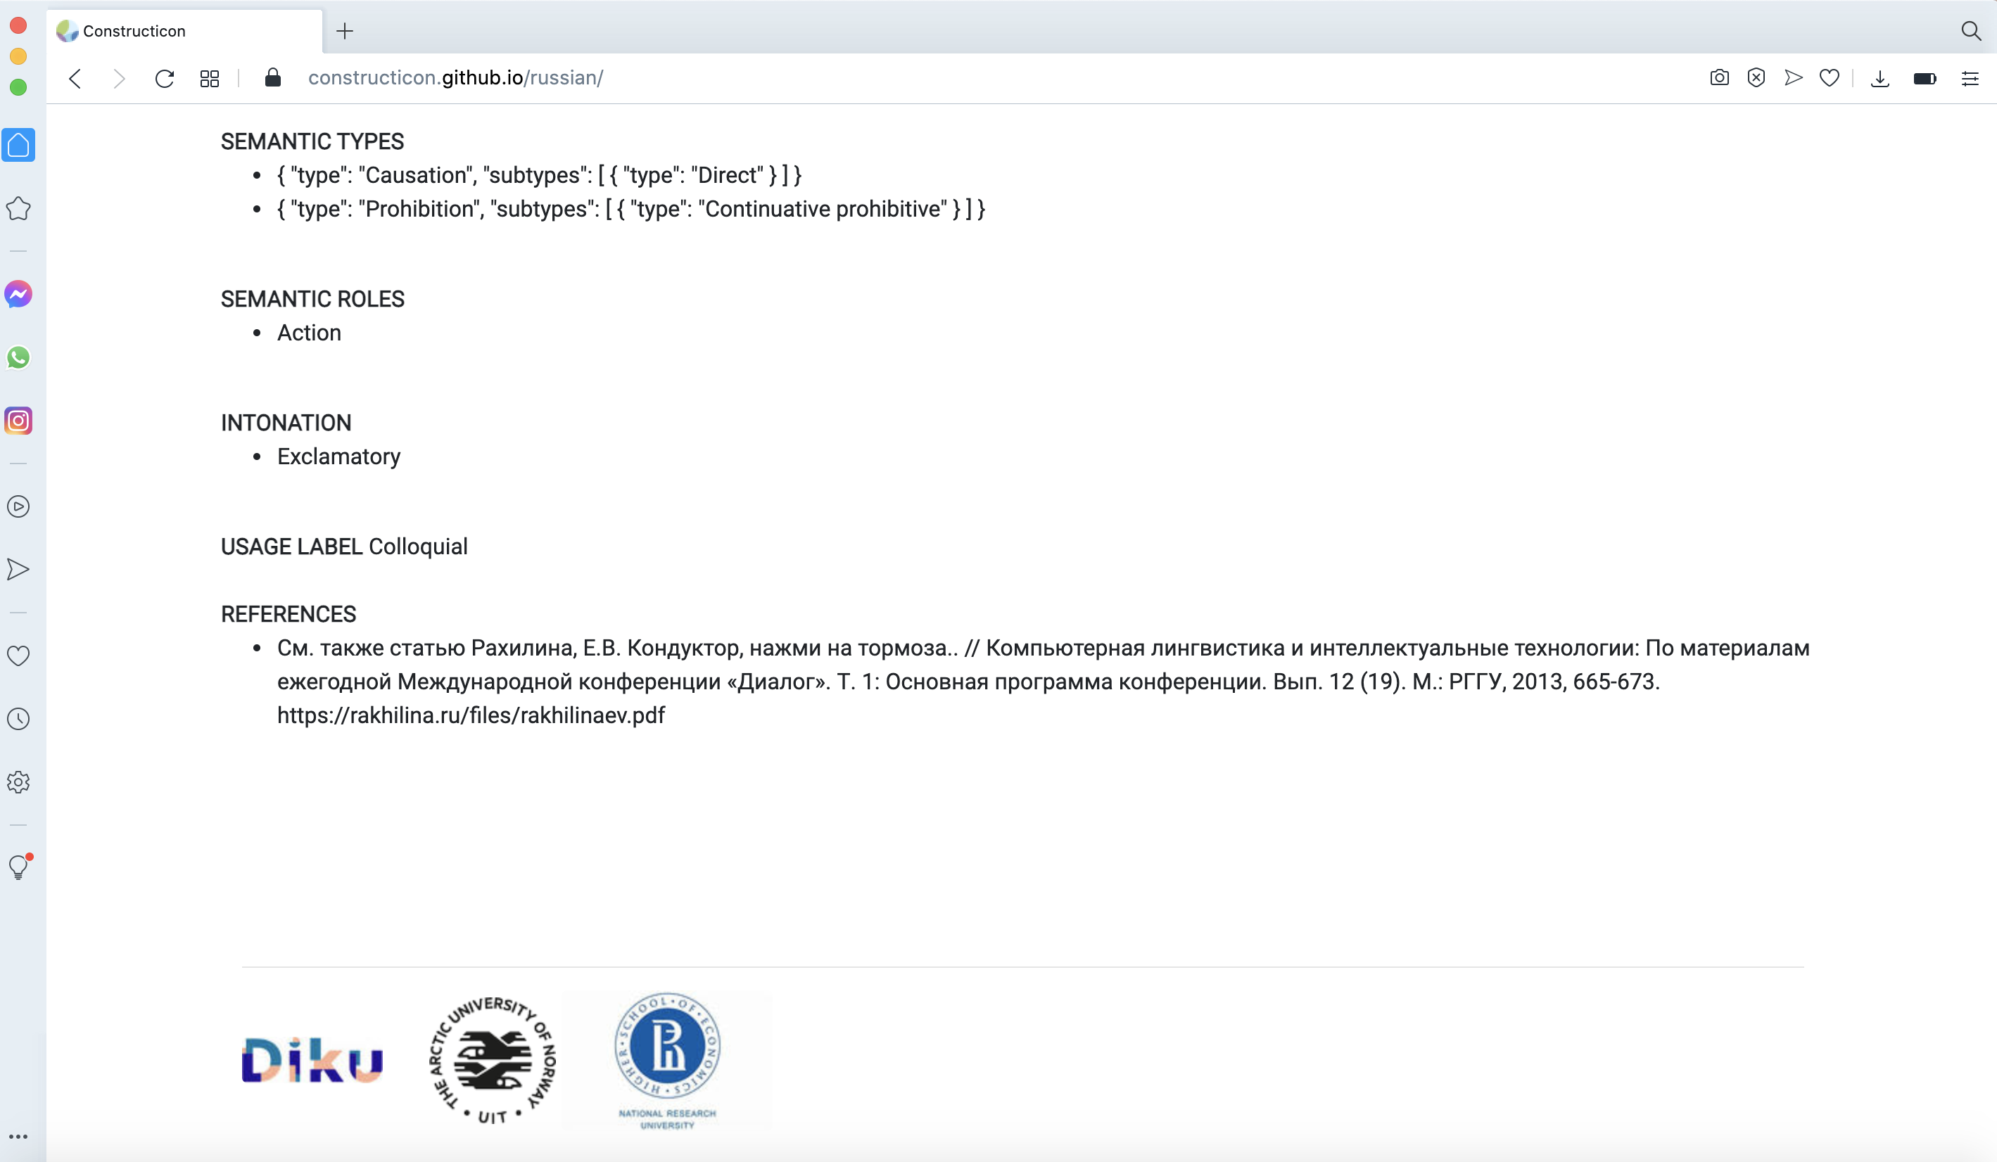
Notes:
And even more.

Slide 36
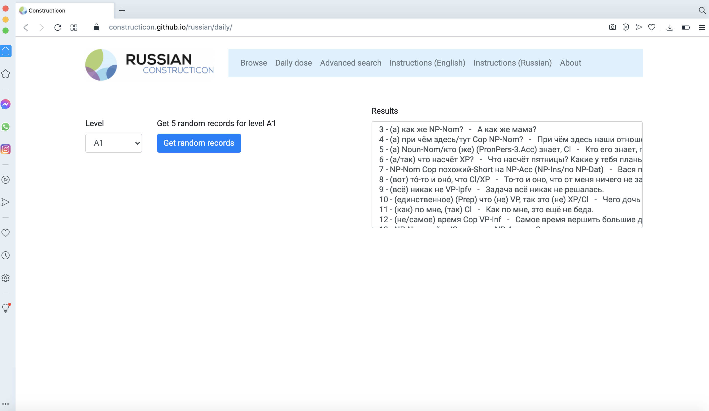
Alternatively, on the Daily Dose page you can get 5 randomly selected constructions that match your level.

Slide 37
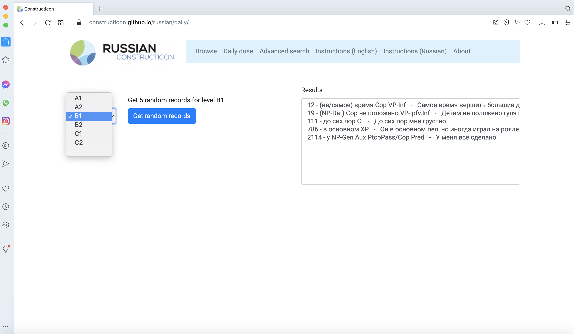
Press the button and get 5 randomly selected constructions that match your level.

Slide 38
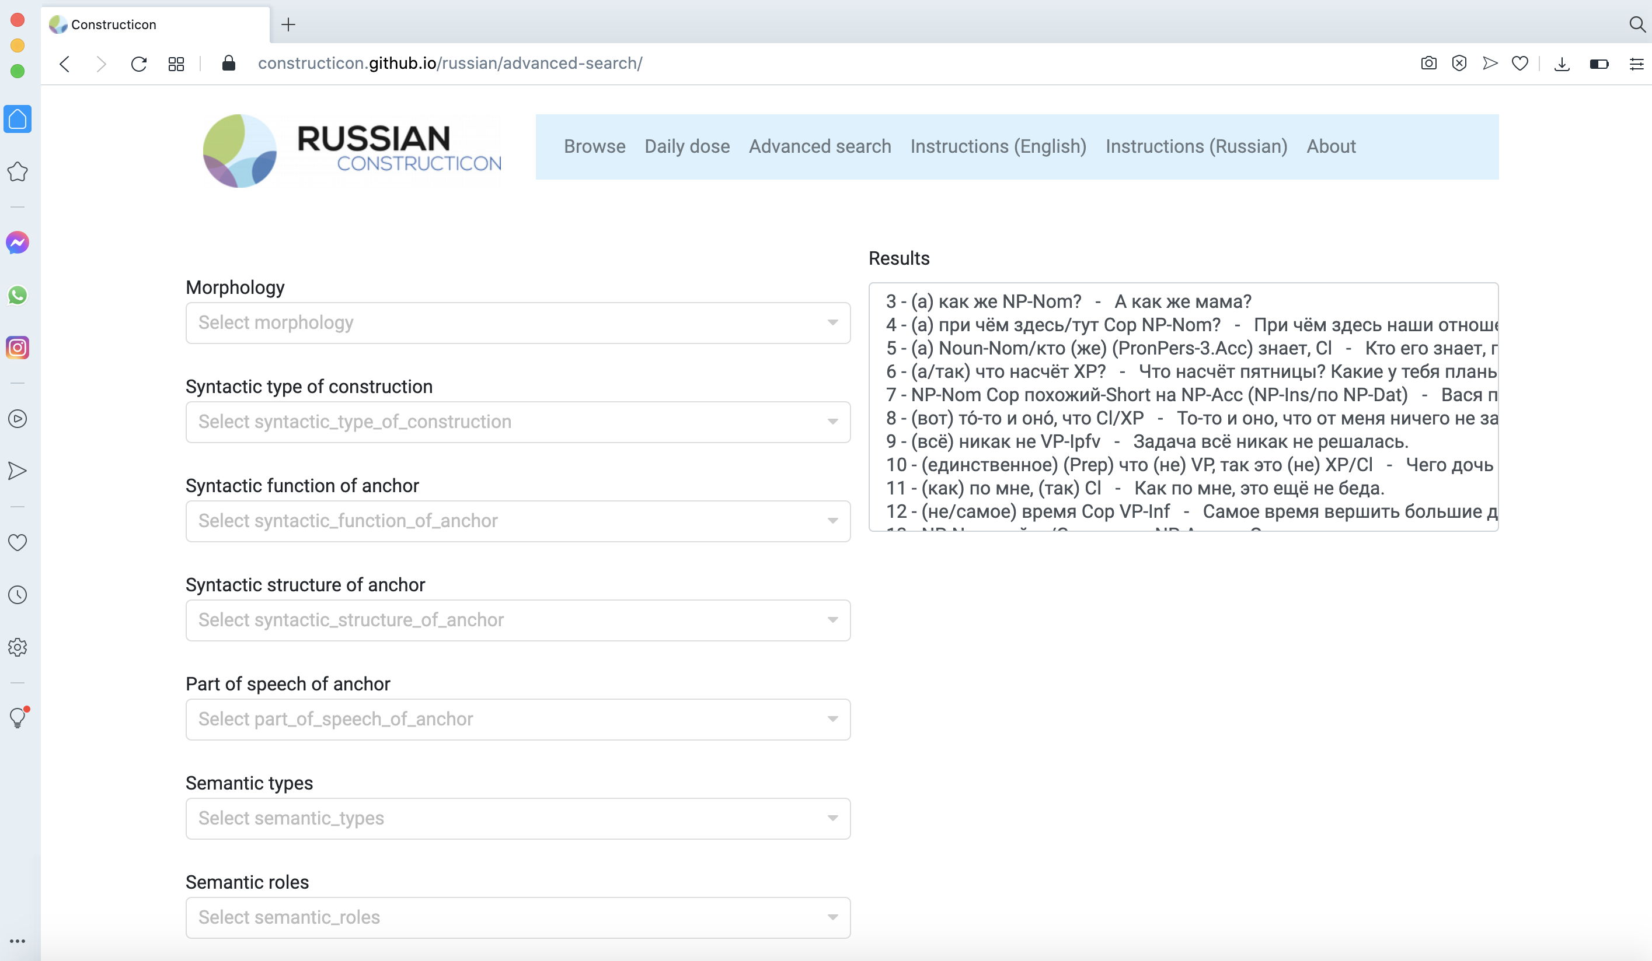
In Advanced Search you can combine as many filters from different windows as you want.

Slide 39
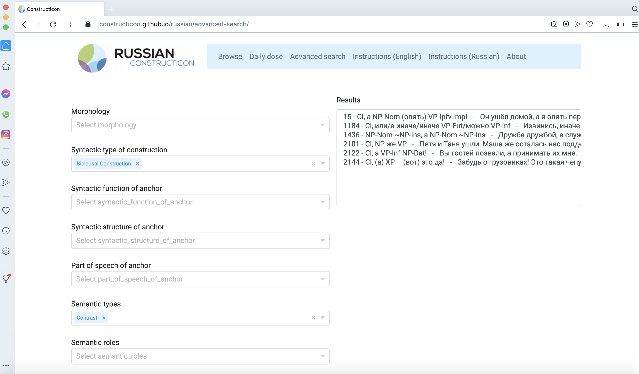
The result will be the intersection, that is those constructions that carry both tags: Biclausal and Contrast.
For example, if you want to find Biclausal constructions that express Contrast – Choose Biclausal in Syntactic type, choose Contrast within Comparison in Semantic type.

Slide 40
To find all constructions at a certain level, you can use Advanced Search, window "Level".

Slide 41
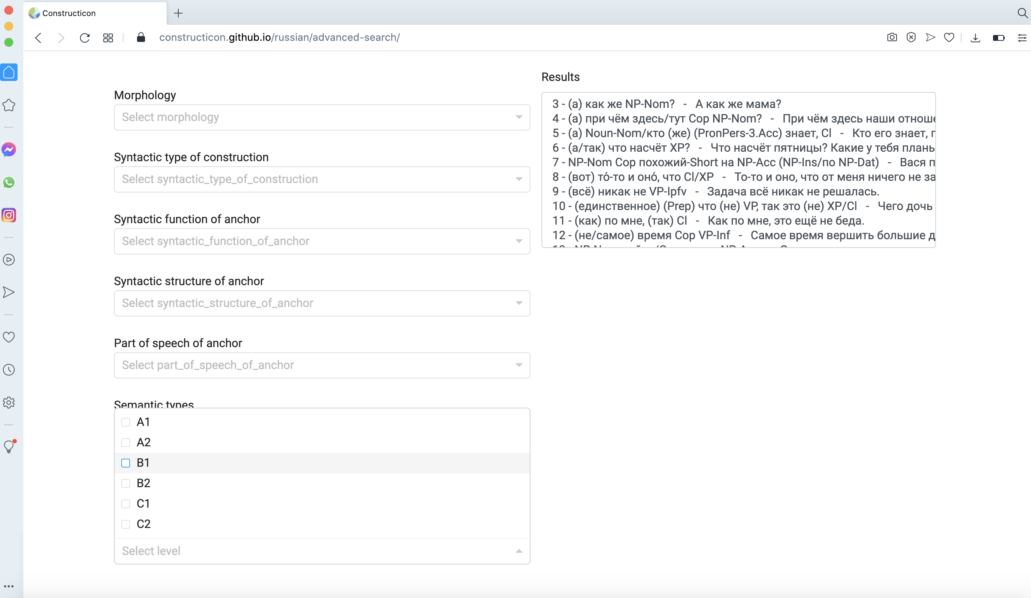
We use the CEFR system of levels (=The Common European Framework of Reference for Languages):
A1 (beginner)
A2 (elementary)
B1 (intermediate)
B2 (upper intermediate)
C1 (advanced)
C2 (superior)
Notes:
add what this means

Slide 42
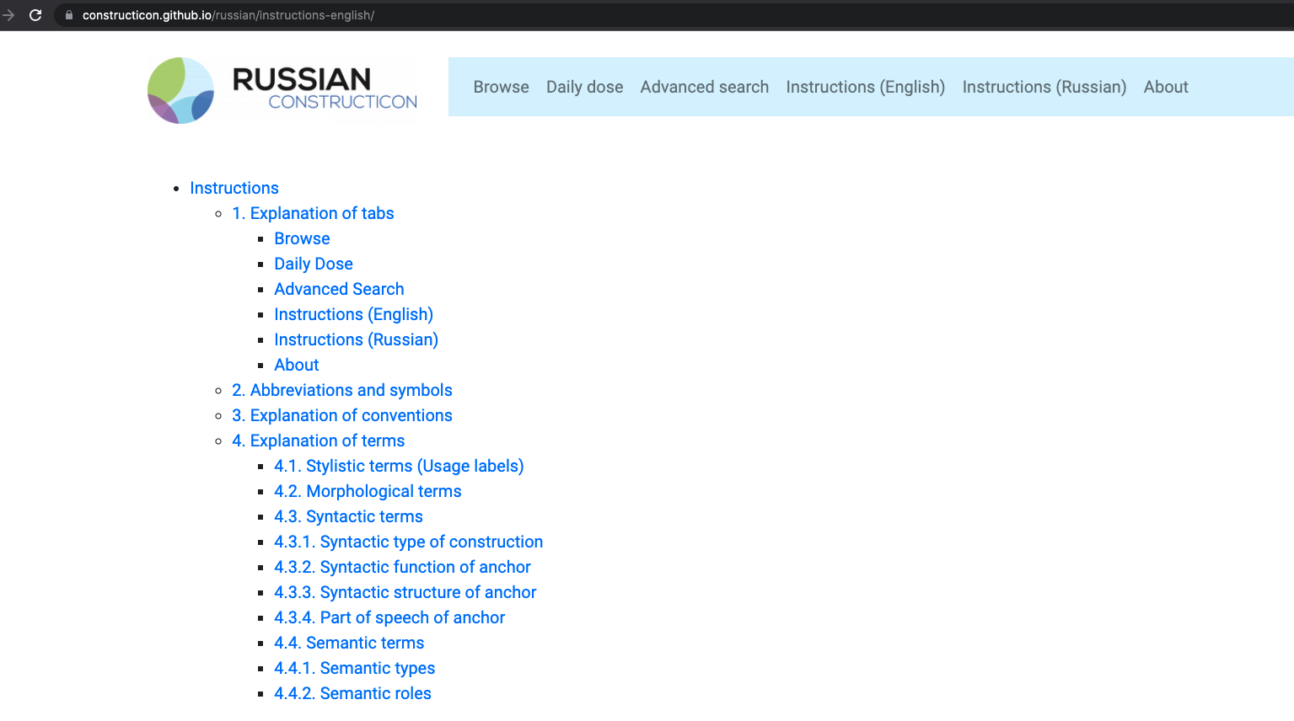

Full descriptions of all features of the site are available on the Instructions page
For example, one can explore the Semantic Types

Slide 43
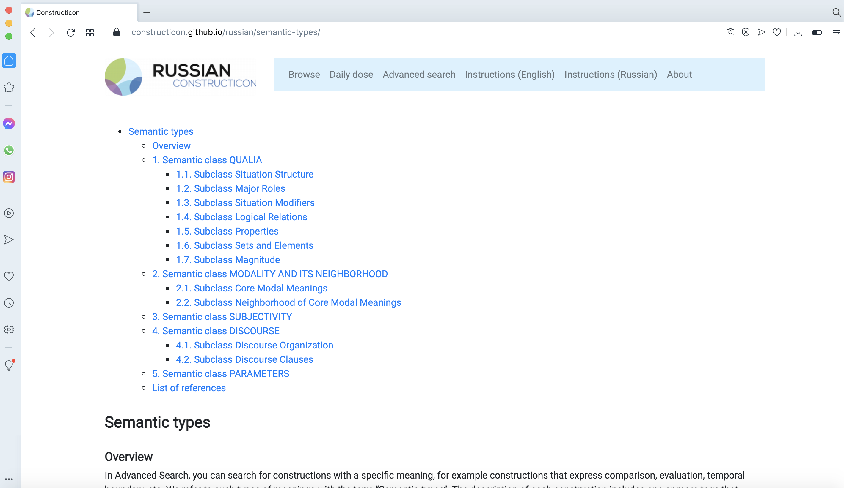
An overview and description of semantic types and subtypes of constructions,
grouped into numbered classes and subclasses.

Slide 44
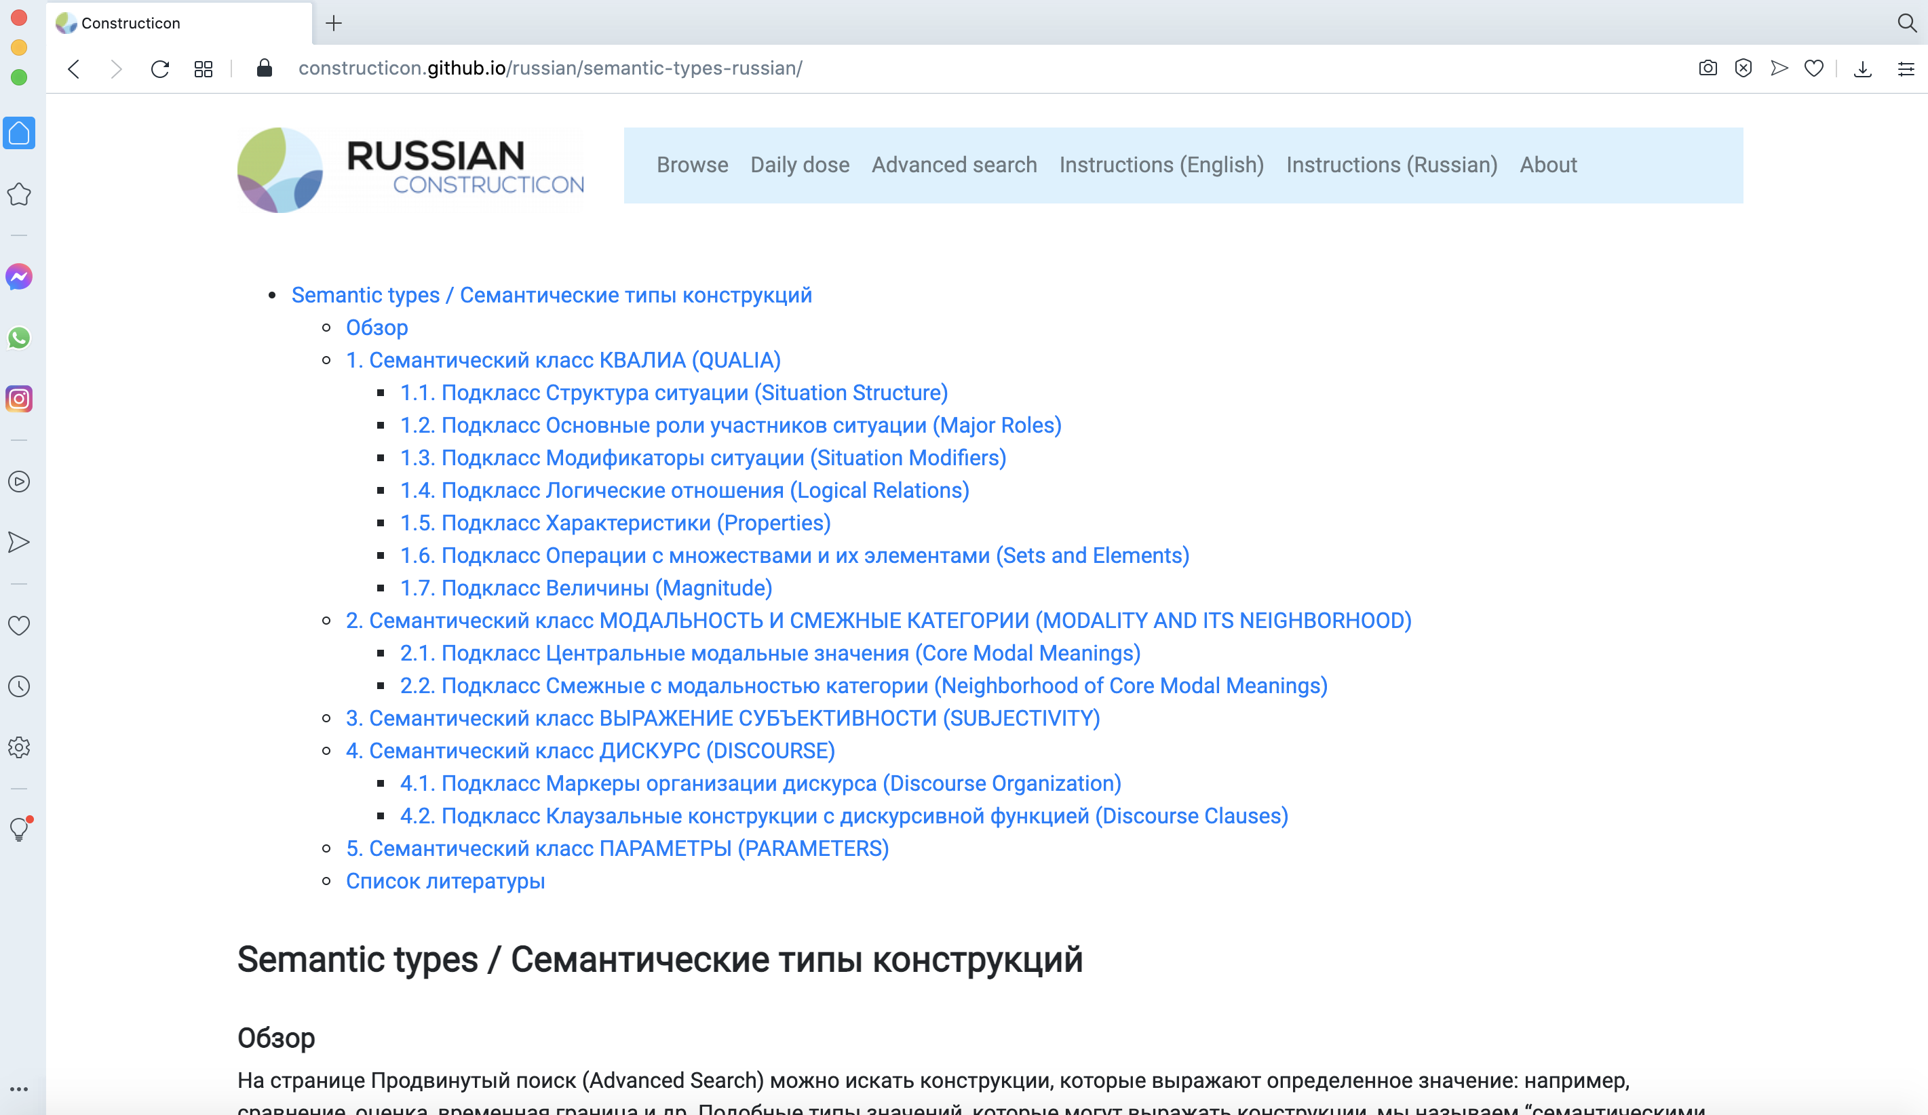
Description is also available in Russian

Slide 45
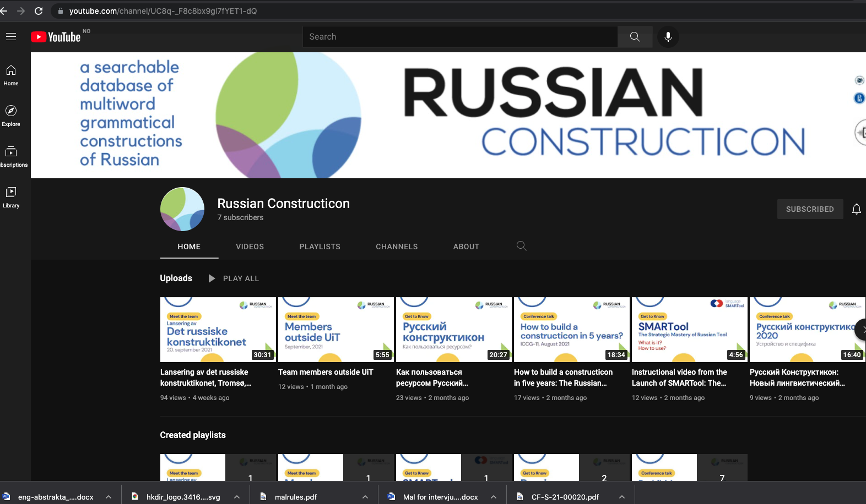
See also instructional videos on our YouTube channel:
https://www.youtube.com/channel/UC8q-_F8c8bx9gI7fYET1-dQ

